Slide 1
FOXSI-2 flight summary
A compilation of quicklook products and ongoing analysis
Last updated April 15, 2015

Slide 2
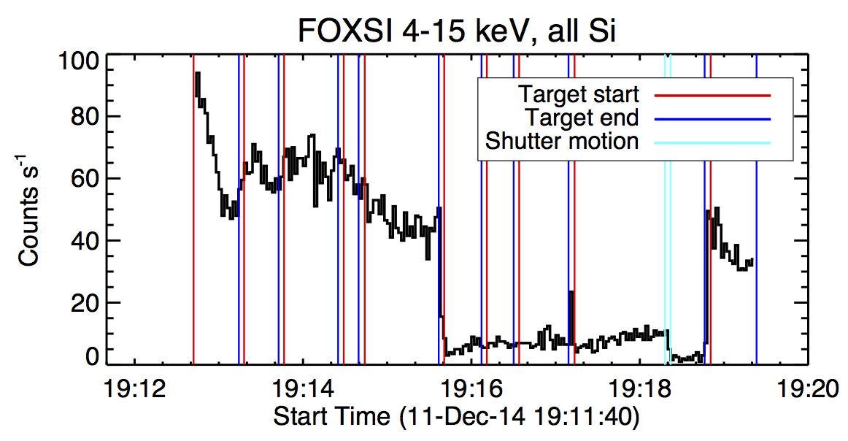
Full time profile; 5 Si det’s summed.

Slide 3
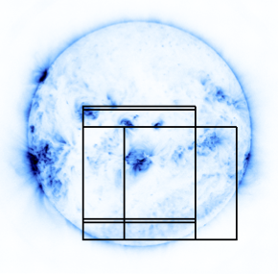
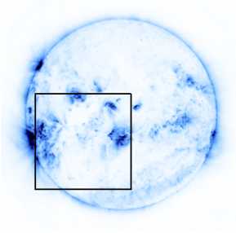
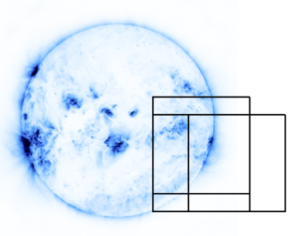
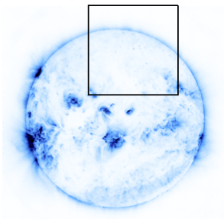
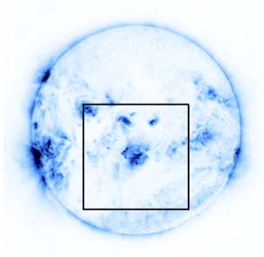

Slide 4
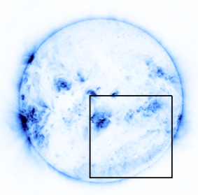
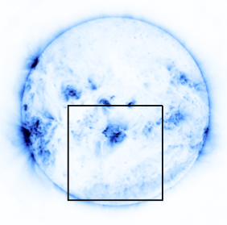
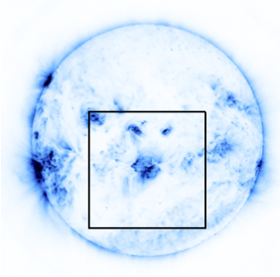
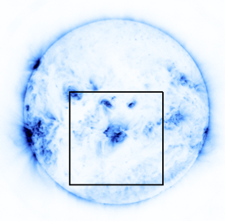

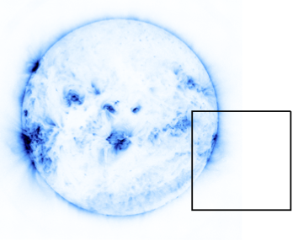
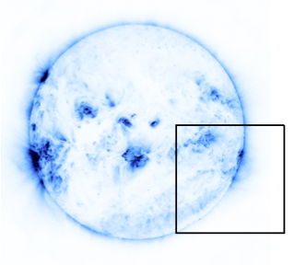
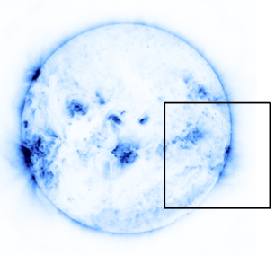

Slide 5
RHESSI
FOXSI-2 flight
Microflares

Slide 6
RHESSI
Microflare in AR12230
Microflare in AR12234

Slide 7
FOXSI-2 Images
All 5 Si detectors
Last image shows all Si added together
Log scale!!!
Times are 36 sec off. (These were produced before the timing offset bug was fixed.)

Slide 8
Target 1, no adjustments
Flare in progress
Times are 36 sec off

Slide 9
Target 1 after first adjustment
Times are 36 sec off

Slide 10
Target 1 after second adjustment
Maybe a 3rd AR?
Times are 36 sec off

Slide 11
Target 1, one last adjustment
Times are 36 sec off

Slide 12
Target 2
Maybe one more AR?
Times are 36 sec off
AR at the limb

Slide 13
Target 3, no adjustment
Not clear if we see the NuSTAR AR or not…
Times are 36 sec off

Slide 14
Target 3 after first adjustment
Times are 36 sec off

Slide 15
Target 3 after second adjustment
Times are 36 sec off

Slide 16
Target 4: Quiet Sun
Times are 36 sec off
This is probably single bounce.

Slide 17
Quiet Sun with shutter in
D6 has no shutter
D4, D5 have no good counts
Times are 36 sec off

Slide 18
Target 5 with shutter in
Now this guy’s flaring.
Times are 36 sec off

Slide 19
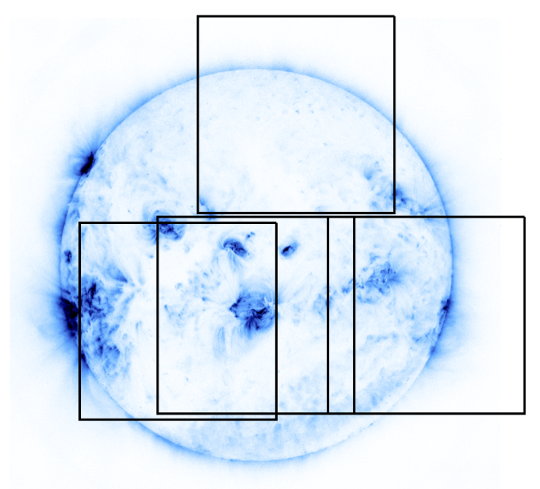
More recent imaging work…
FOXSI lightcurves
AR 12230
AR 12234
GOES 1-8A
Microflares
RHESSI 4-8 keV
Notes:
Update figures and note energy range. Add vertical bars showing target times.

Slide 20
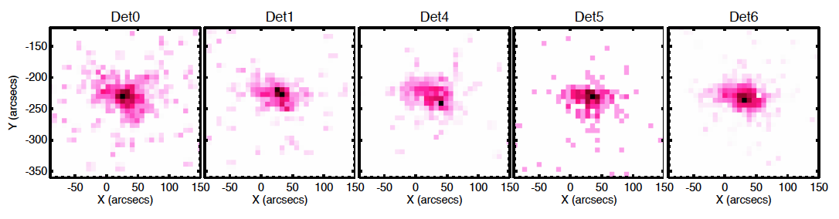
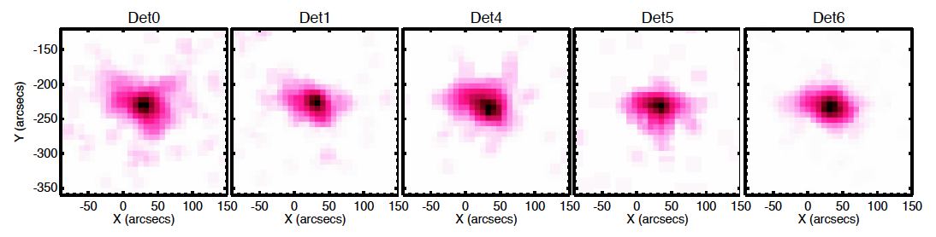
AR 12230 microflare – FOXSI Si detectors
Smoothed over 2 pix

Slide 21
Overlays on AIA

Slide 22
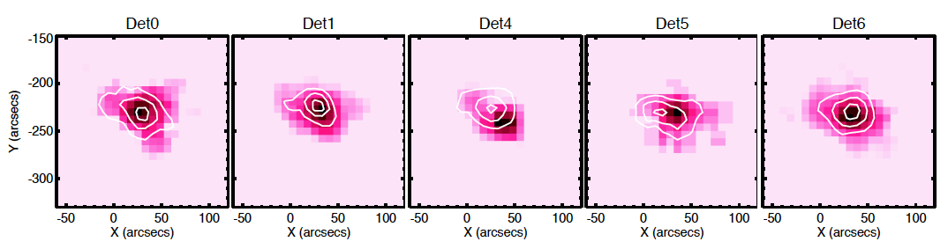
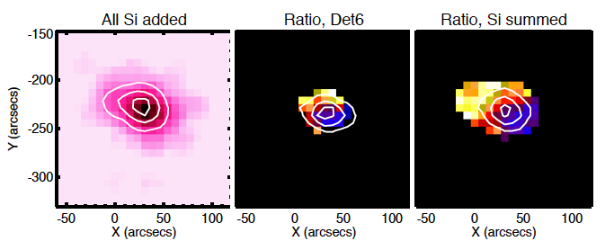
Imaging spectroscopy
Pink: 4-5.5 keV
Black: 6-9 keV

Slide 23
Photon spectra
(very preliminary!)
No fine updates to calibration yet.

Slide 24
Spectra, each target (only intervals after pointing adjustments)
Detector 6 has no attenuator
Attenuator is in!

Slide 25
Incident photon spectrum
Not yet accurate – some detector effects have not yet been included!

Slide 26
Comparison with VLA, Target 1

